Slide 1
Soccer chemistry
Simon leahy

Slide 2
equation
inputs
goals
Capital
Competitive Persuasion
Limited Skill Pool
Salary Cap
Build or amend current team
Minimize negative impact of limiting inputs
Yield higher offensive success (league adjusted)

Slide 3
Chemistry
purpose
Intended Kpis
Optimal combination of player skillsets
Identify key skillsets, combinations of skillsets, and variance of skillsets that contribute most to offensive success
Top 5 offensively inclined players from each team across 5 different leagues
Subset’s Avg and St. dev. of each available offensive skill
Delta between overall skill and individual attributes

Slide 4
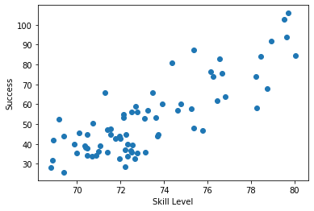
Initial hypothesis confirmation
Linear regression
Confirm relationship between offensive skill and success
Multivariate (.81) and univariate regression (.82)

Slide 5
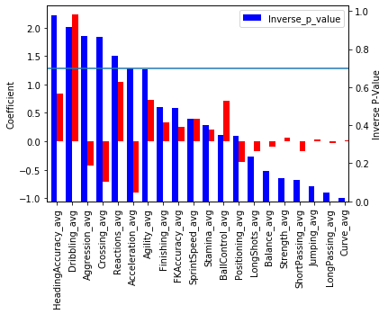
regression results
Metrics
Accuracy, dribbling, and reactions have strong positive impact on offensive success (basic multivariate linear regression)

Slide 6
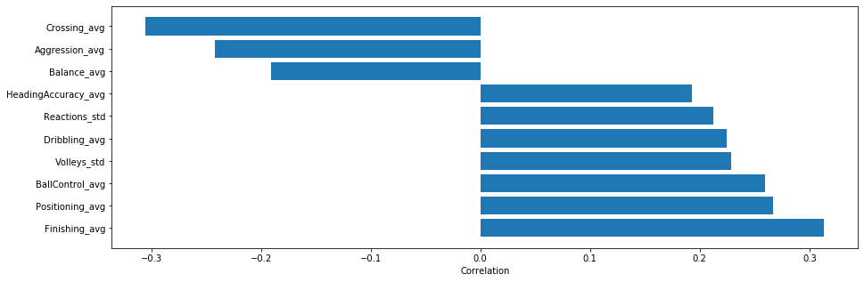
Attribute Delta vs residual assessment
concept
Impact of delta between attribute and all attribute average on residual of expected vs. actual success
Uncovers attributes that contribute to over or underperformance based on overall skills
Key Attributes- Finishing, Positioning, Ball Control,
Volleys std., Reactions std., Dribbling, Heading
Accuracy
Overrated attributes- Crossing, Aggression, Balance

